Slide 1

Linear Regression
Project

Slide 2
01
Understanding
02
Data-preparation
To Understand dataset, Choose the target to predict, and features to analysis
Data source
Pipeline
Wrangling, Exploration & Cleaning
03
Modeling
04
Feature Engineering
Modeling training
Measure model performance
Next step

Slide 3
Data Extraction
BeautifulSoup
Dataset
Database
Fast, beginner friendly.
500000 rows
17 columns
GCP

Slide 4
Choose Target
Target
Target: price
Eight Features are: categories, pages, weights, review stars, number of reviews, book format, media reviews (based on common sense)
Missing values
Null
Drop all the null apart from media review, I assume whether a book have media review have impact on the price
Various data types
Type
Categorical, float, int, binary.
Checking duplicates
Duplicates
No
Data
preparation
Some interesting outliers
Outliers
The most pages are : 793460 worth £100
The most weight: 99kg
One hot encoding
Encoding
Encoding categorical data into numerical

Slide 5
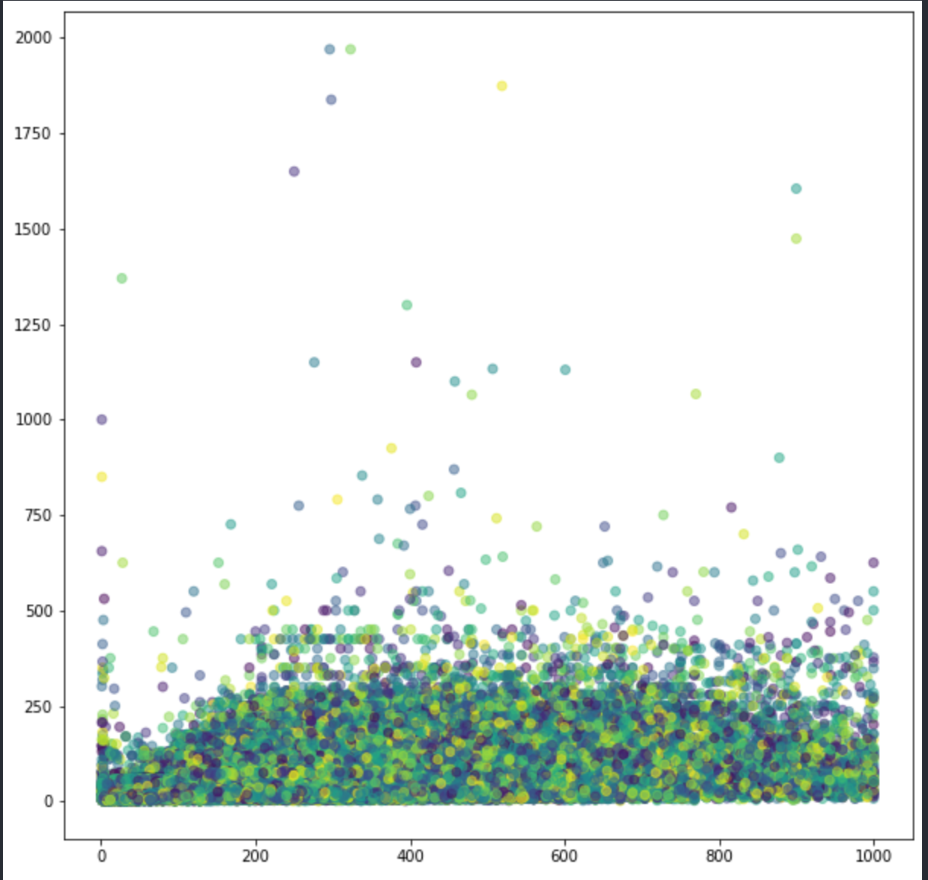
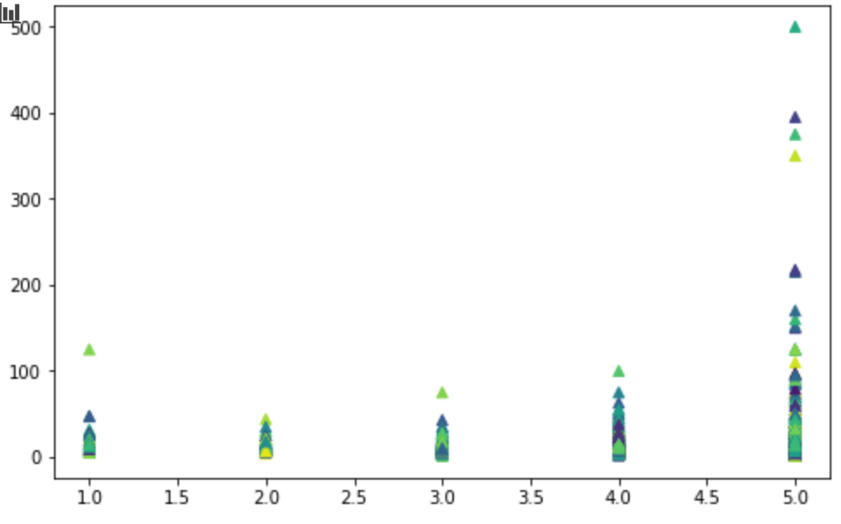
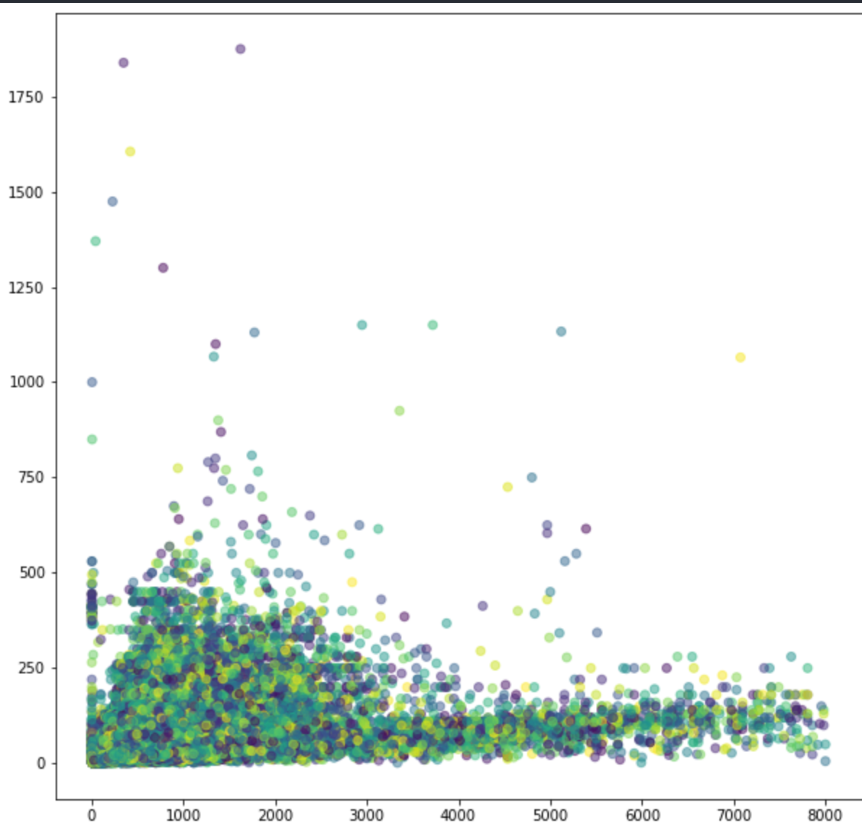
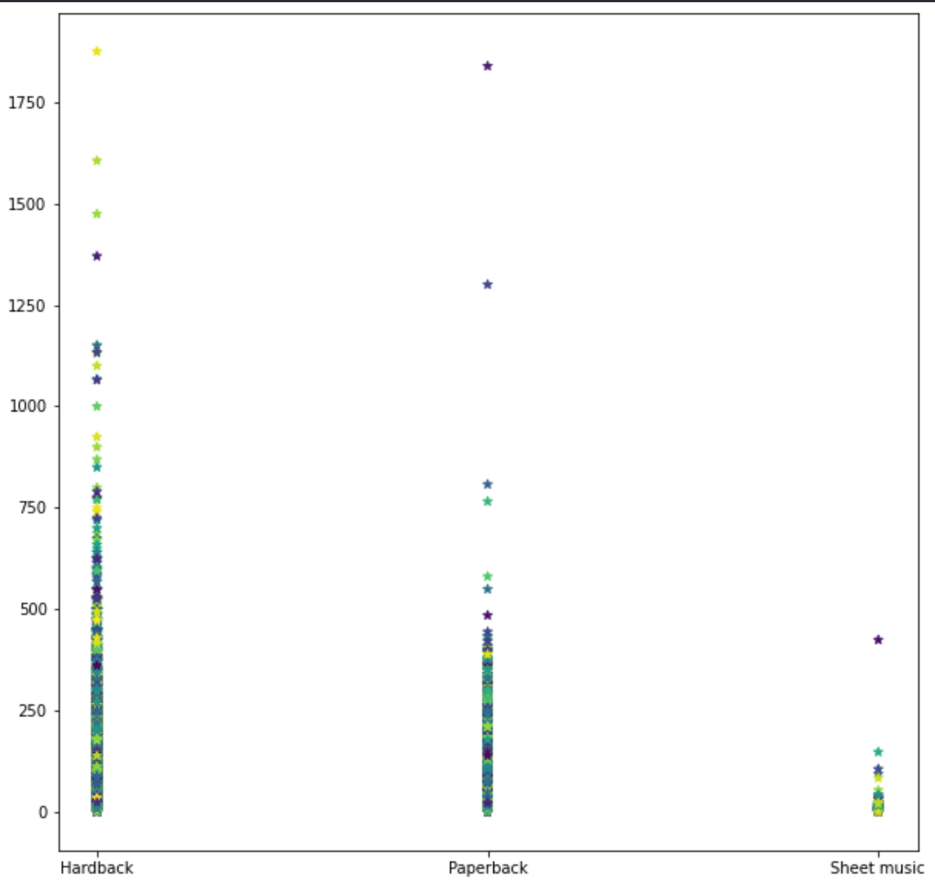
Visual EDA
Scatter plot between price and each feaure
X: pages
Y: price
X: number of review stars
Y: price
X: book weight
Y: price
X: book format
Y: price

Slide 6
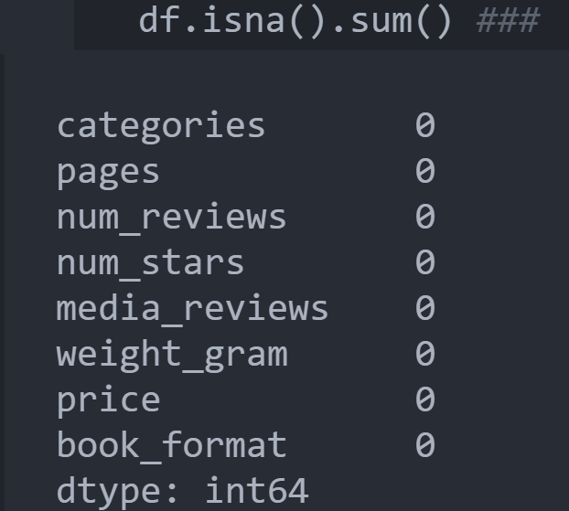
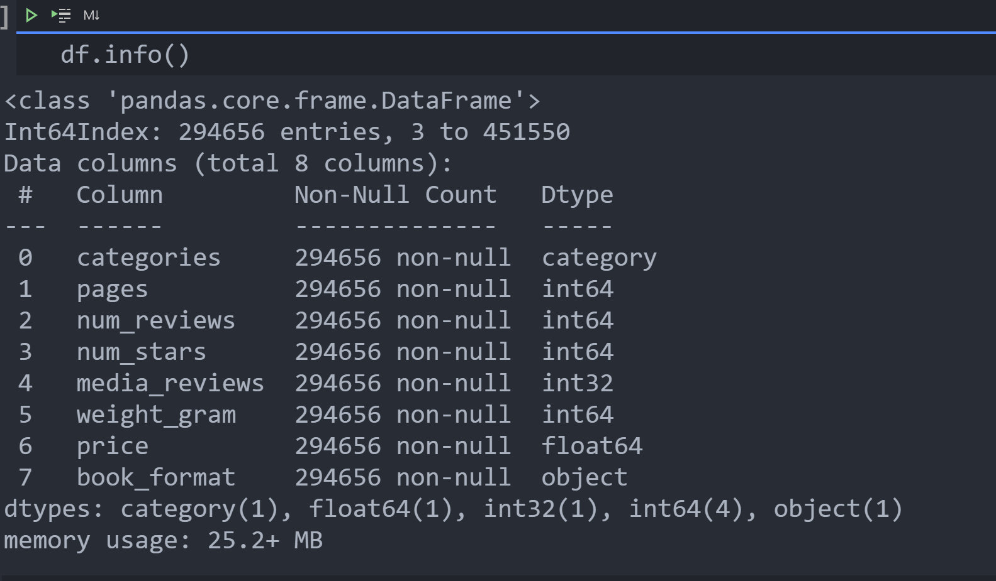

Slide 7
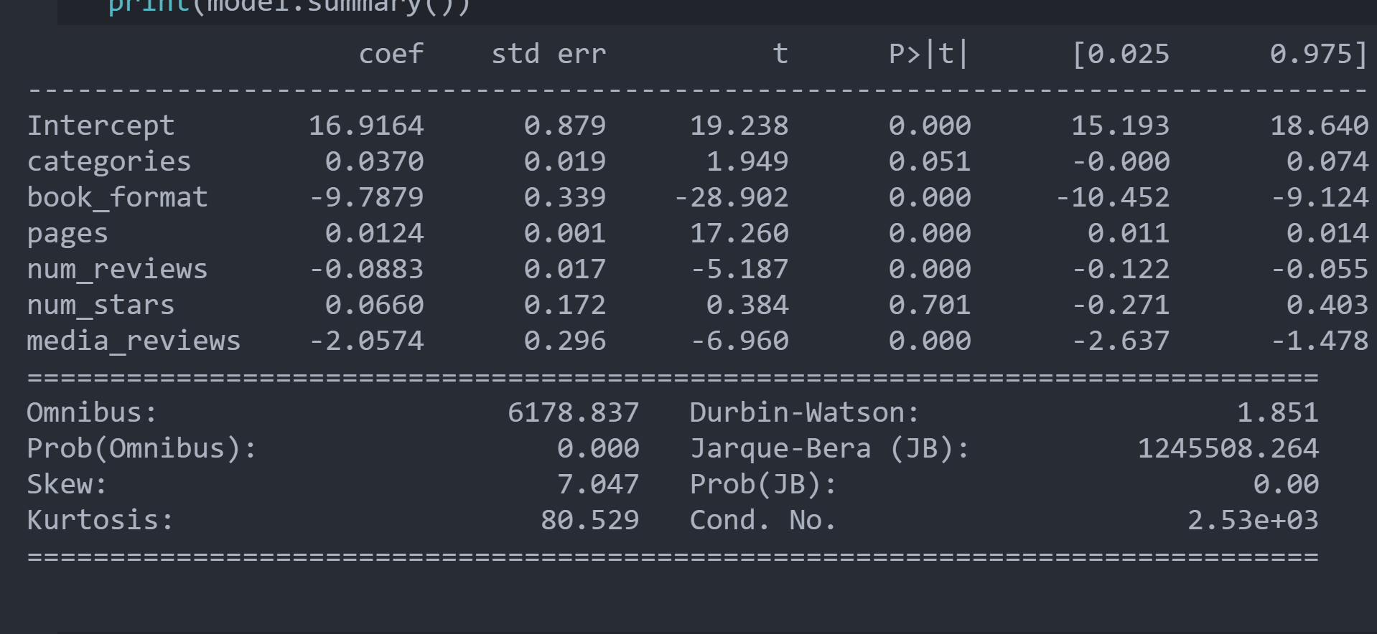
OLS
Regression
P-value help with feature selection
drop
Number of reviews

Slide 8
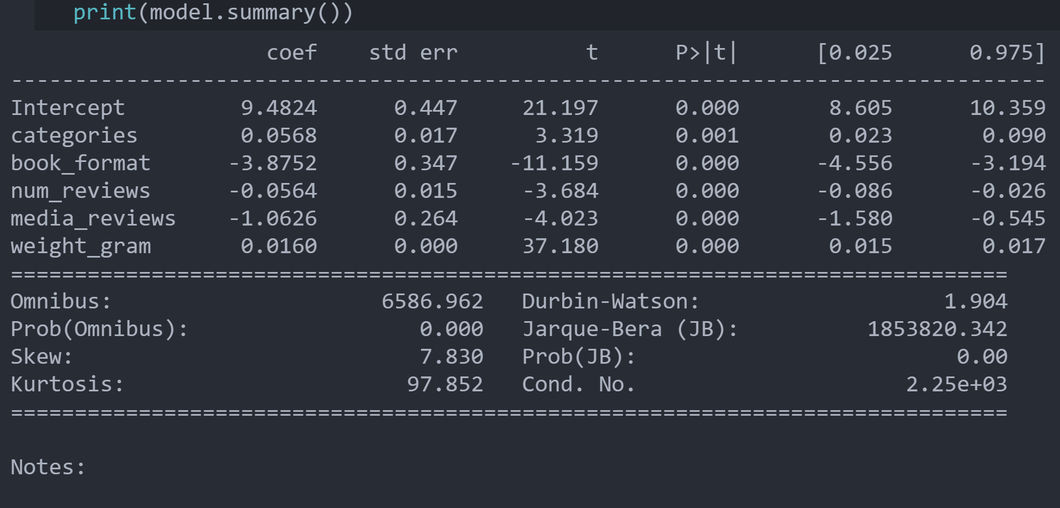
After selection
P-value
Contents A | Add Text | Add Text | Add Text | Add Text
Contents B | Content Here | Content Here | Content Here | Content Here
Contents C | Add Text | Add Text | Add Text | Add Text
Contents D | Content Here | Content Here | Content Here | Content Here
Contents E | Add Text | Add Text | Add Text | Add Text
Contents F | Content Here | Content Here | Content Here | Content Here
Contents G | Add Text | Add Text | Add Text | Add Text

Slide 9
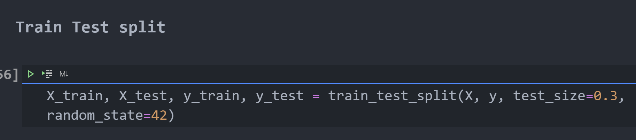

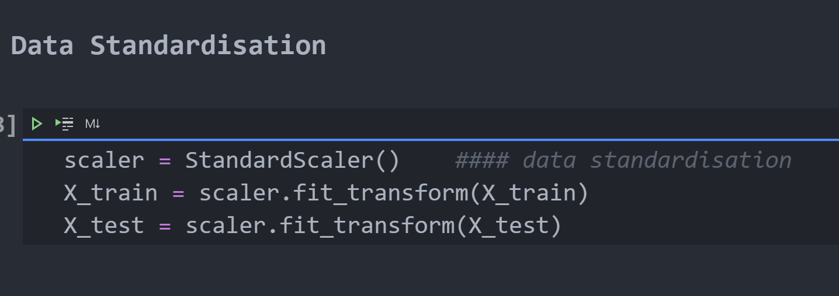
Train/Test Split
Train Test
7%
Data normalisation
MinMax Scaler
StandardScaler
All values are within the new range of 0 and 1.
Subtracting the mean value or centering the data

Slide 10
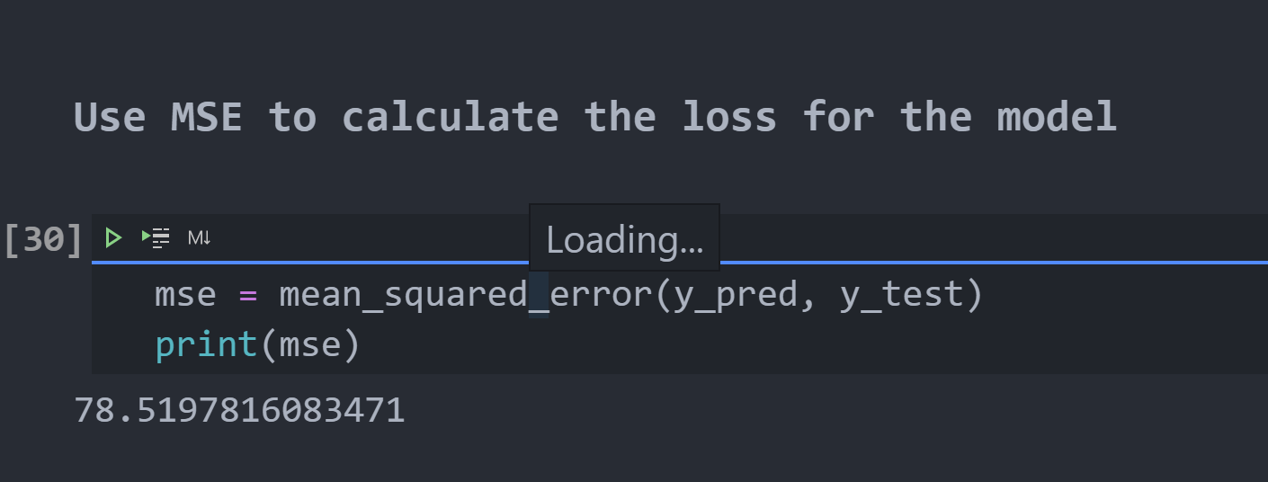
Modeling
Library:sklearn
The Loss Function
Fit model on training dataset
MSE: get loss: 3.65
Make prediction on the test set

Slide 11
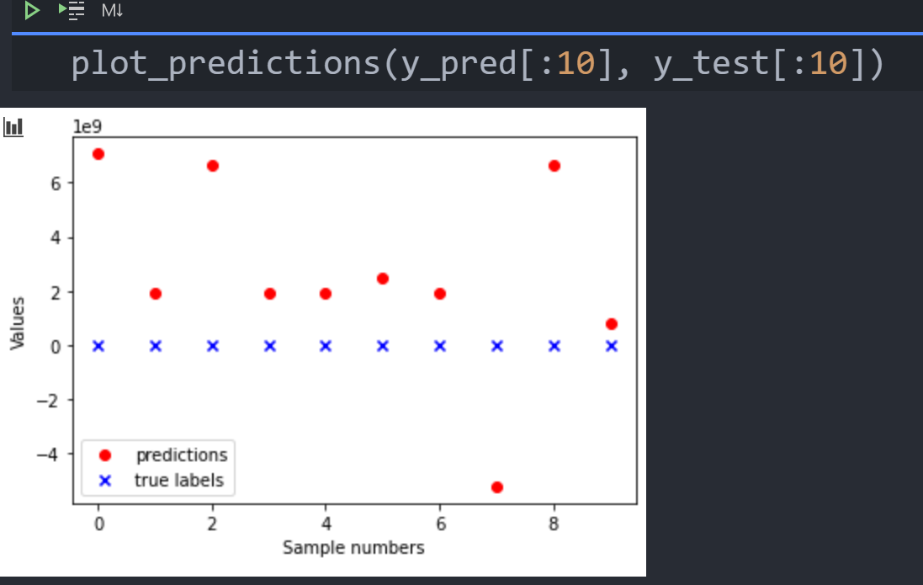
Plot Result
The residuals between y_pred and y_test
R-Squared
0.42
35%
Add Text Here
Add Text Here
Add Text Here
Add Text Here
Add Text Here
Add Text Here
Add Text Here
Add Text Here
Add Text Here
Add Text Here
Add Text Here
Add Text Here

Slide 12
Next Step
Make this model better
Cross-Validation
Classification
Predicting categories
Learn Classification models
Learn sentiment analysis
Explore book review data

Slide 13

Sharing

Slide 14
THANK YOU

